Slide 1
Recipe4Meals
A Project for BLG-411E Class

Slide 2
Objective of the Project
The goal is to develop an android application that :
Provides a series of recipes of dishes
Presenting a step by step walkthrough on how to prepare dishes
Suggesting meals according to ingredients, meal times, cuisines

Slide 3
Meet Our Team
Name | ID | Role
Ali Osman ATİK | 150140804 | Project Manager / Programmer
İbrahim TÜRKMEN | 150140002 | Software Designer / Programmer
Baran KAYA | 150130032 | Tester / Programmer
Caner IŞIK | 150130023 | Database Designer / Programmer
Emre YENİAY | 150110013 | Analyzer / Programmer

Slide 4
Technical Details
The components and tools used in the project:
IDE: Android Studio
Repository: GitHub
Database: NoSQL
Backend Service: Google Firebase

Slide 5
Features
The project has 3 main features:
Find the recipe you wanted easily
Comment and rate the recipe you reviewed
Share a new recipe with other users

Slide 6
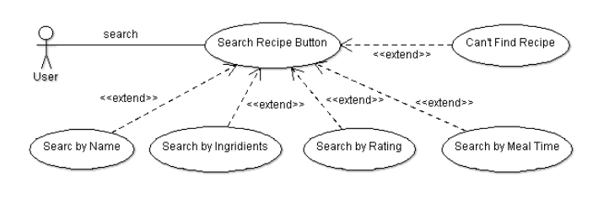
Search & Filter
By ingredients
By rating
By meal time
By name

Slide 7
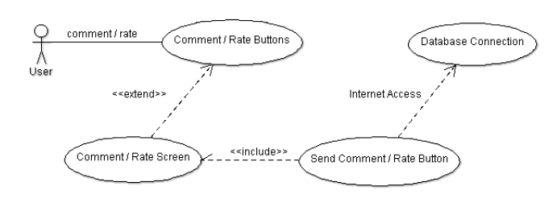
Comment and Rate
Users can comment and give points to recipe
Database is updated in real time

Slide 8
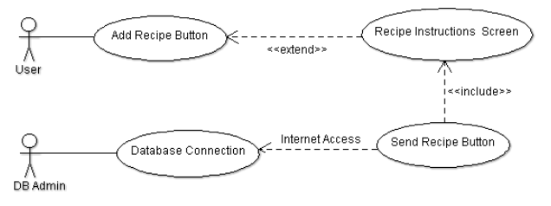
Add Recipe
Introduced by customers request
Enter the ingredients, instructions, cuisine etc.
Checked and added to system by admins later

Slide 9
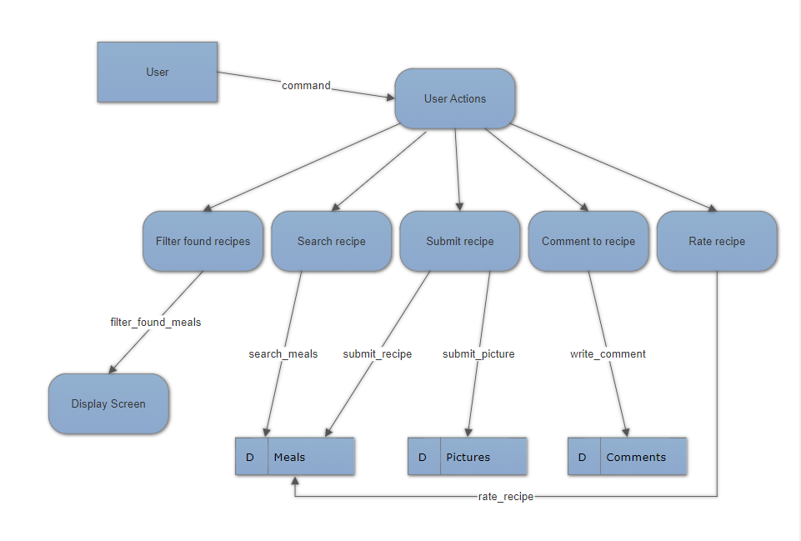

Slide 10
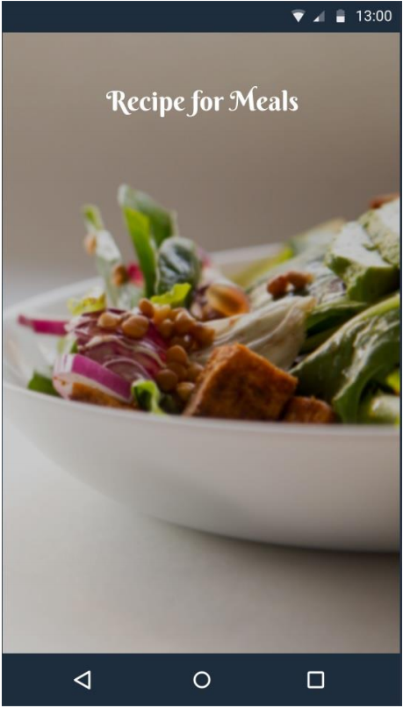
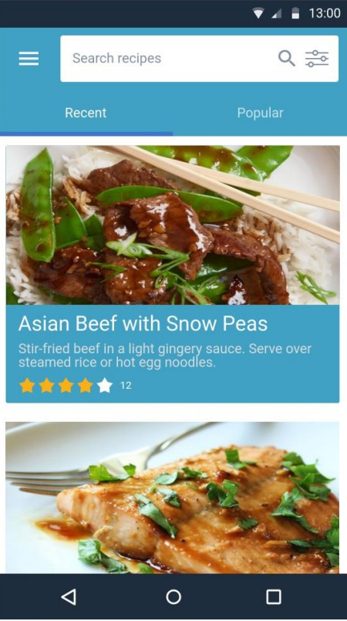

Slide 11
